Slide 1

Distributed Systems The second half of Parallel and Distributed Systems (CIS6007) Studio 8.1 : Models of distributed systems
Lecturer: Dr Rehmat Ullah (rullah@cardiffmet.ac.uk)
Credits: The content in this lecture is adapted from slides originally designed by Dr. Martin Kleppmann (University of Cambridge)
1

Slide 2
Recap
Client-server systems
Remote procedure call (RPC)
Stub
Marshalling
Location Transparency
RPC History
Practical examples
RPC in enterprise systems

Slide 3
Models of distributed systems

Slide 4
The two generals problem
city
attack?
attack?
army 1 |  | army 2
 | messengers

Slide 5
The two generals problem
city
attack?
attack?
army 1 |  | army 2
 | messengers
army 1 | army 2 | outcome
does not attack | does not attack | nothing happens
attacks | does not attack | army 1 defeated
does not attack | attacks | army 2 defeated
attacks | attacks | city captured
Desired: army 1 attacks if and only if army 2 attacks

Slide 6
The two generals problem
general 1
general 2
attack 10 Nov, okay?
10 Nov agreed!

Slide 7
How should the generals decide?
General 1 always attacks, even if no response is received?
Send lots of messengers to increase probability that one will get through
If all are captured, general 2 does not know about the attack, so general 1 loses

Slide 8
How should the generals decide?
General 1 always attacks, even if no response is received?
Send lots of messengers to increase probability that one will get through
If all are captured, general 2 does not know about the attack, so general 1 loses
General 1 only attacks if positive response from general 2 is received?
Now general 1 is safe
But general 2 knows that general 1 will only attack if general 2’s response gets through
Now general 2 is in the same situation as general 1 in option 1

Slide 9
How should the generals decide?
General 1 always attacks, even if no response is received?
Send lots of messengers to increase probability that one will get through
If all are captured, general 2 does not know about the attack, so general 1 loses
General 1 only attacks if positive response from general 2 is received?
Now general 1 is safe
But general 2 knows that general 1 will only attack if general 2’s response gets through
Now general 2 is in the same situation as general 1 in option 1
No common knowledge: the only way of knowing something is to communicate it

Slide 10
The two generals problem applied
customer
dispatch goods
charge credit card
Online shop |  | Payments service
RPC

Slide 11
The two generals problem applied
customer
dispatch goods
charge credit card
online shop |  | Payments service
RPC
online shop | payments service | outcome
does not dispatch | does not charge | nothing happens
dispatches | does not charge | shop loses money
does not dispatch | charges | customer complaint
dispatches | charges | everyone happy
Desired: online shop dispatches if and only if payment made

Slide 12
The Byzantine generals problem
army 3
attack?
messengers
messengers
city
attack?
attack?
army 1 |  | army 2
 | messengers
Problem: some of the generals might be traitors

Slide 13
Generals who might lie
general 1
general 2
general 3
attack!
attack!
general 1 said retreat!

Slide 14
Generals who might lie
general 1
general 2
general 3
attack!
attack!
general 1 said retreat!
From general 3’s point of view, this is indistinguishable from:
general 1
general 2
general 3
attack!
retreat!
general 1 said retreat!

Slide 15
The Byzantine generals problem
Each general is either malicious or honest
Up to f generals might be malicious
Honest generals don’t know who the malicious ones are
The malicious generals may collude
Nevertheless, honest generals must agree on plan

Slide 16
The Byzantine generals problem
Each general is either malicious or honest
Up to f generals might be malicious
Honest generals don’t know who the malicious ones are
The malicious generals may collude
Nevertheless, honest generals must agree on plan
Theorem: need 3f + 1 generals in total to tolerate f
malicious generals (i.e. < ^{1/3} may be malicious)
Cryptography (digital signatures) helps – but problem remains hard

Slide 17
Trust relationships and malicious behaviour
customer
agree?
RPC
RPC
order
agree?
agree?
online shop |  | payments service
RPC
Who can trust whom?

Slide 18
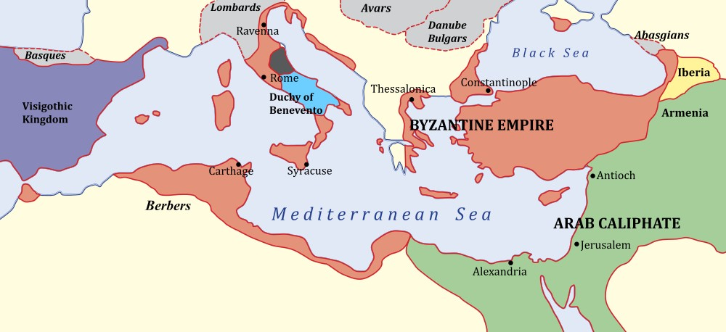
The Byzantine empire (650 CE)
Byzantium/Constantinople/Istanbul
Source: https://commons.wikimedia.org/wiki/File:Byzantiumby650AD.svg
“Byzantine” has long been used for “excessively complicated, bureaucratic, devious” (e.g. “the Byzantine tax law”)

Slide 19
System models
We have seen two thought experiments:
Two generals problem:
a model of networks
Byzantine generals problem:
a model of node behaviour In real systems, both nodes and networks may be faulty!

Slide 20
System models
We have seen two thought experiments:
Two generals problem:
a model of networks
Byzantine generals problem:
a model of node behaviour In real systems, both nodes and networks may be faulty!
Capture assumptions in a system model consisting of:
Network behaviour (e.g. message loss)
Node behaviour (e.g. crashes)
Timing behaviour (e.g. latency) Choice of models for each of these parts.

Slide 21
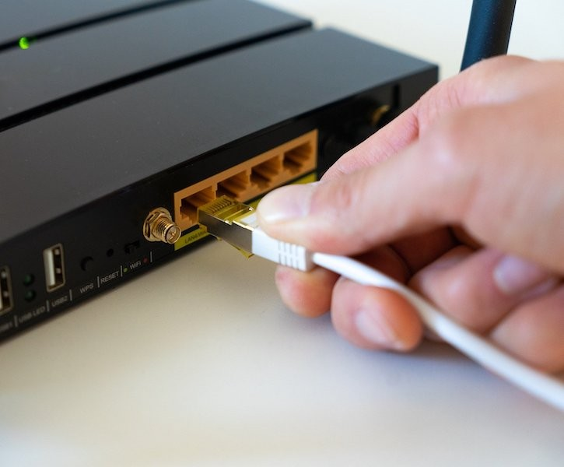
Networks are unreliable

Slide 22

In the sea, sharks bite fibre optic cables
https://slate.com/technology/2014/08/
shark-attacks-threaten-google-s-undersea-internet-cables-video.html

Slide 23
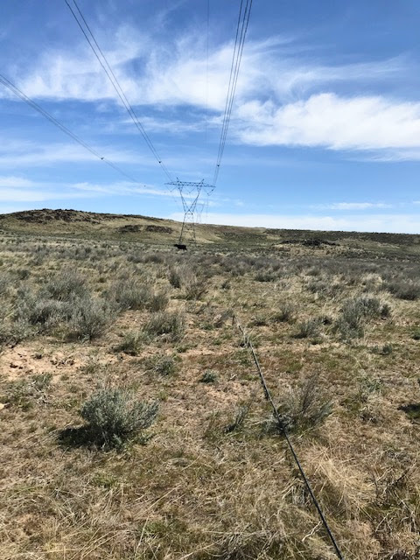
On land, cows step on the cables
https://twitter.com/uhoelzle/status/1263333283107991558

Slide 24
System model: network behaviour
Assume bidirectional point-to-point communication between two nodes, with one of:

Slide 25
System model: network behaviour
Assume bidirectional point-to-point communication between two nodes, with one of:
Reliable (perfect) links:
A message is received if and only if it is sent. Messages may be reordered.

Slide 26
System model: network behaviour
Assume bidirectional point-to-point communication between two nodes, with one of:
Reliable (perfect) links:
A message is received if and only if it is sent. Messages may be reordered.
Fair-loss links:
Messages may be lost, duplicated, or reordered.
If you keep retrying, a message eventually gets through.

Slide 27
System model: network behaviour
Assume bidirectional point-to-point communication between two nodes, with one of:
Reliable (perfect) links:
A message is received if and only if it is sent. Messages may be reordered.
Fair-loss links:
Messages may be lost, duplicated, or reordered.
If you keep retrying, a message eventually gets through.
Arbitrary links (active adversary):
A malicious adversary may interfere with messages (eavesdrop, modify, drop, spoof, replay).

Slide 28
System model: network behaviour
Assume bidirectional point-to-point communication between two nodes, with one of:
Reliable (perfect) links:
A message is received if and only if it is sent. Messages may be reordered.
Fair-loss links:
Messages may be lost, duplicated, or reordered.
If you keep retrying, a message eventually gets through.
Arbitrary links (active adversary):
A malicious adversary may interfere with messages (eavesdrop, modify, drop, spoof, replay).
Network partition: some links dropping/delaying all messages for extended period of time

Slide 29
System model: network behaviour
Assume bidirectional point-to-point communication between two nodes, with one of:
Reliable (perfect) links:
A message is received if and only if it is sent.
Messages may be reordered.
Fair-loss links:
Messages may be lost, duplicated, or reordered.
retry +dedup
If you keep retrying, a message eventually gets through.
Arbitrary links (active adversary):
A malicious adversary may interfere with messages (eavesdrop, modify, drop, spoof, replay).
Network partition: some links dropping/delaying all messages for extended period of time

Slide 30
System model: network behaviour
Assume bidirectional point-to-point communication between two nodes, with one of:
Reliable (perfect) links:
A message is received if and only if it is sent.
Messages may be reordered.
Fair-loss links:
Messages may be lost, duplicated, or reordered.
retry +dedup
If you keep retrying, a message eventually gets through.
Arbitrary links (active adversary):
A malicious adversary may interfere with messages (eavesdrop, modify, drop, spoof, replay).
TLS
Network partition: some links dropping/delaying all messages for extended period of time

Slide 31
System model: node behaviour
Each node executes a specified algorithm, assuming one of the following:
Crash-stop (fail-stop):
A node is faulty if it crashes (at any moment). After crashing, it stops executing forever.

Slide 32
System model: node behaviour
Each node executes a specified algorithm, assuming one of the following:
Crash-stop (fail-stop):
A node is faulty if it crashes (at any moment). After crashing, it stops executing forever.
Crash-recovery (fail-recovery):
A node may crash at any moment, losing its in-memory state. It may resume executing sometime later.
Data stored on disk survives the crash.

Slide 33
System model: node behaviour
Each node executes a specified algorithm, assuming one of the following:
Crash-stop (fail-stop):
A node is faulty if it crashes (at any moment). After crashing, it stops executing forever.
Crash-recovery (fail-recovery):
A node may crash at any moment, losing its in-memory state. It may resume executing sometime later.
Data stored on disk survives the crash.
Byzantine (fail-arbitrary):
A node is faulty if it deviates from the algorithm. Faulty nodes may do anything, including crashing or malicious behaviour.
A node that is not faulty is called “correct”

Slide 34
System model: synchrony (timing) assumptions
Assume one of the following for network and nodes:
Synchronous:
Message latency no greater than a known upper bound. Nodes execute algorithm at a known speed.

Slide 35
System model: synchrony (timing) assumptions
Assume one of the following for network and nodes:
Synchronous:
Message latency no greater than a known upper bound. Nodes execute algorithm at a known speed.
Partially synchronous:
The system is asynchronous for some finite (but unknown) periods of time, synchronous otherwise.

Slide 36
System model: synchrony (timing) assumptions
Assume one of the following for network and nodes:
Synchronous:
Message latency no greater than a known upper bound. Nodes execute algorithm at a known speed.
Partially synchronous:
The system is asynchronous for some finite (but unknown) periods of time, synchronous otherwise.
Asynchronous:
Messages can be delayed arbitrarily. Nodes can pause execution arbitrarily. No timing guarantees at all.
Note: other parts of computer science use the terms “synchronous” and “asynchronous” differently.

Slide 37
Violations of synchrony in practice
Networks usually have quite predictable latency, which can occasionally increase:
Message loss requiring retry
Congestion/contention causing queueing
Network/route reconfiguration

Slide 38
Violations of synchrony in practice
Networks usually have quite predictable latency, which can occasionally increase:
Message loss requiring retry
Congestion/contention causing queueing
Network/route reconfiguration
Nodes usually execute code at a predictable speed, with occasional pauses:
Operating system scheduling issues, e.g. priority inversion
Stop-the-world garbage collection pauses
Page faults, swap, thrashing
Real-time operating systems (RTOS) provide scheduling guarantees, but most distributed systems do not use RTOS

Slide 39
Availability
Online shop wants to sell stuff 24/7!
Service unavailability = downtime = losing money
Availability = uptime = fraction of time that a service is functioning correctly
“Two nines” = 99% up = down 3.7 days/year
“Three nines” = 99.9% up = down 8.8 hours/year
“Four nines” = 99.99% up = down 53 minutes/year
“Five nines” = 99.999% up = down 5.3 minutes/year

Slide 40
Availability
Online shop wants to sell stuff 24/7!
Service unavailability = downtime = losing money
Availability = uptime = fraction of time that a service is functioning correctly
“Two nines” = 99% up = down 3.7 days/year
“Three nines” = 99.9% up = down 8.8 hours/year
“Four nines” = 99.99% up = down 53 minutes/year
“Five nines” = 99.999% up = down 5.3 minutes/year
Service-Level Objective (SLO):
e.g. “99.9% of requests in a day get a response in 200 ms”
Service-Level Agreement (SLA):
contract specifying some SLO, penalties for violation

Slide 41
Achieving high availability: fault tolerance
Failure: system as a whole isn’t working
Fault: some part of the system isn’t working
Node fault: crash (crash-stop/crash-recovery), deviating from algorithm (Byzantine)
Network fault: dropping or significantly delaying messages
Fault tolerance:
system as a whole continues working, despite faults (up to some maximum number of faults)
Single point of failure (SPOF): node/network link whose fault leads to failure

Slide 42
Failure detectors
Failure detector:
algorithm that detects whether another node is faulty
Perfect failure detector:
labels a node as faulty if and only if it has crashed

Slide 43
Failure detectors
Failure detector:
algorithm that detects whether another node is faulty
Perfect failure detector:
labels a node as faulty if and only if it has crashed
Typical implementation for crash-stop/crash-recovery: send message, await response, label node as crashed if no reply within some timeout

Slide 44
Failure detectors
Failure detector:
algorithm that detects whether another node is faulty
Perfect failure detector:
labels a node as faulty if and only if it has crashed
Typical implementation for crash-stop/crash-recovery: send message, await response, label node as crashed if no reply within some timeout
Problem:
cannot tell the difference between crashed node, temporarily unresponsive node, lost message, and delayed message

Slide 45
Failure detection in partially synchronous systems
Perfect timeout-based failure detector exists only in a synchronous crash-stop system with reliable links.
Eventually perfect failure detector:
May temporarily label a node as crashed, even though it is correct
May temporarily label a node as correct, even though it has crashed
But eventually, labels a node as crashed if and only if it has crashed
Reflects fact that detection is not instantaneous, and we may have spurious timeouts

Slide 46
System models summary
For each of the three parts, pick one:
Network:
reliable, fair-loss, or arbitrary
Nodes:
crash-stop, crash-recovery, or Byzantine
Timing:
synchronous, partially synchronous, or asynchronous
This is the basis for any distributed algorithm. If your assumptions are wrong, all bets are off!

